Slide 1
Internal organization and actions
Board of Directors: 3 – 3
Full members: 42 - 8
All 2020 WEBINARS at the Academy (monthly, COVID related, Nobel prizes): 23 - 9

Slide 2

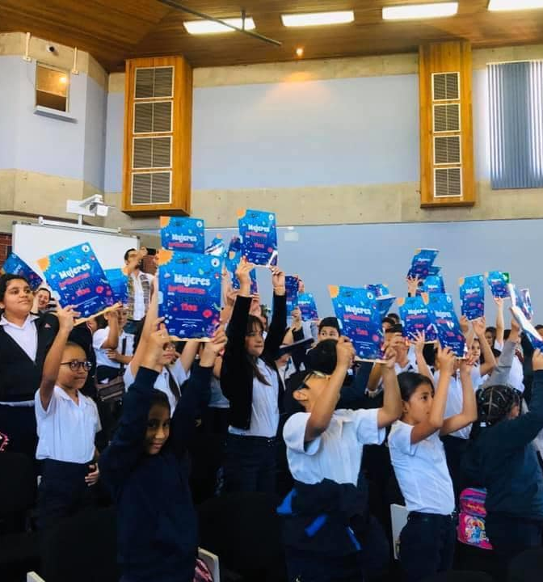
Activities to increase girls' interest in science:
Coloring book for children with female scientists
Activities for Girls in Science
Short video “Women In STEM”
3-day VIRTUAL forum “Women in STEM: how to overcome barriers to equality?”
400 inscribed participants
Several media interviews
Posters, videos, round tables, discussions
Conclusions and recommendations pending
https://www.youtube.com/channel/UCqn0Z3z5o33iP3fInAsaEYQ

Slide 3
Specific actions with others
IANAS Books on Senior Researchers and Women outside Academia
Collaboration with Ministry of Science and Technology
Selection committee for the Biannual Prize to an outstanding female scientist career
Participation in the action plan of the NATIONAL POLICY ON GENDER EQUALITY IN STEM (2017).

