Slide 1


WFs IANAS 24.10.2022
Bolivia

Slide 2
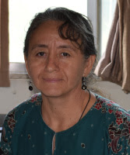
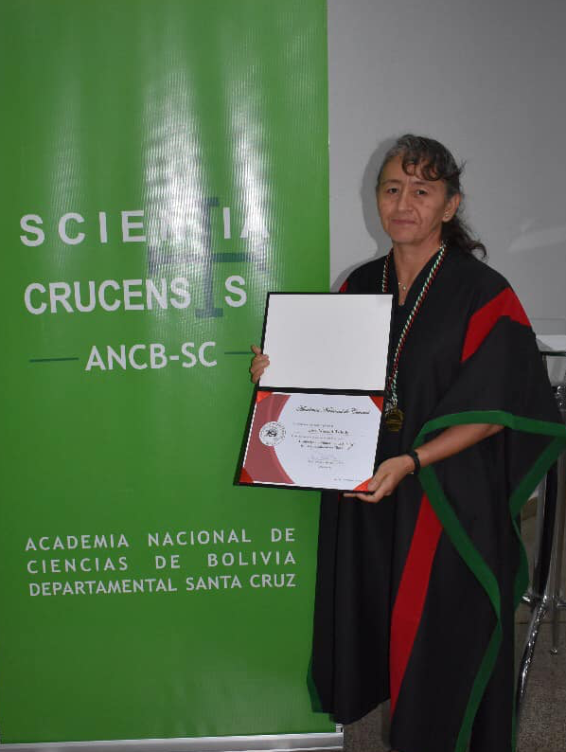
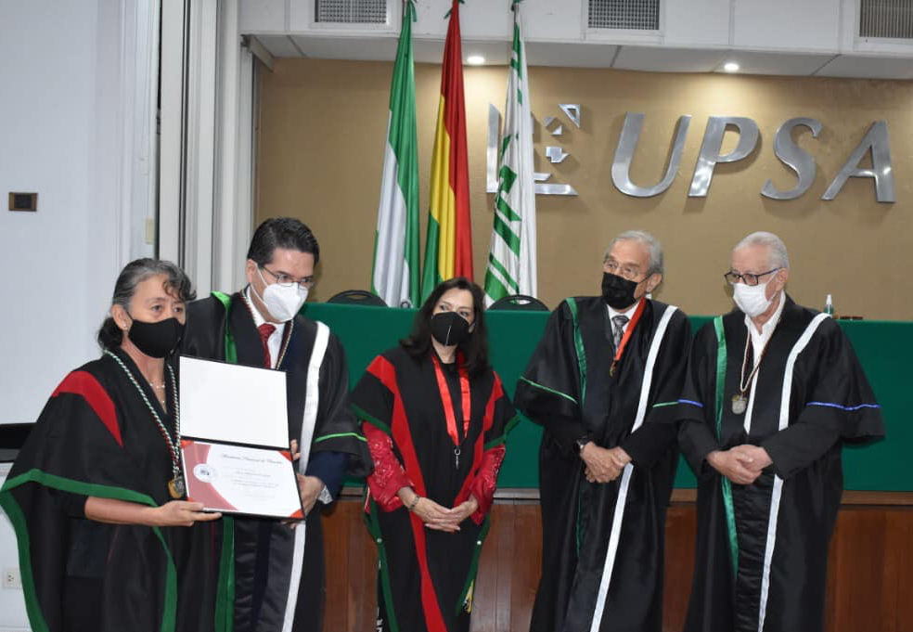
New female academician 2022
Biologist, PhD Marisol Toledo
On February 23, 2022, in an honor session of the National Academy of Sciences, in the Santa Cruz Chapter, the biologist researcher Dr. Marisol Toledo entered as Number Academician.

Slide 3
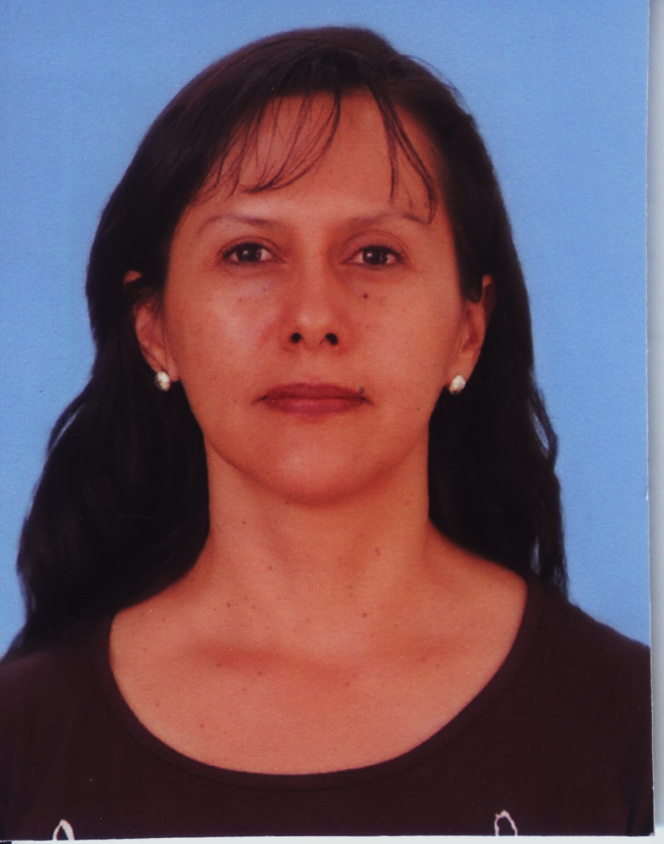
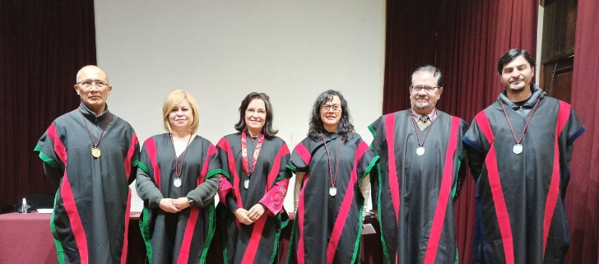
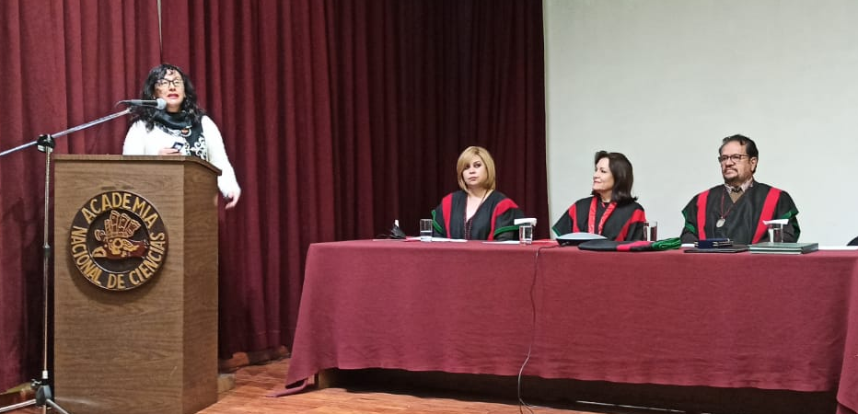
New female academician 2022
Two female professionals have been nominated to the National Academy of Sciences for 2022. One of them have been invited to present their admission work
Agronomist, PhD Ximena Cadima
On June 15, 2022, in an honor session held at the National Academy of Sciences, the agronomist researcher Dr. Ximena Cadima entered as Number Academician. The work that she presented to enter in the institution was:
“Management of the diversity of native crops in Andean agricultural systems”

Slide 4
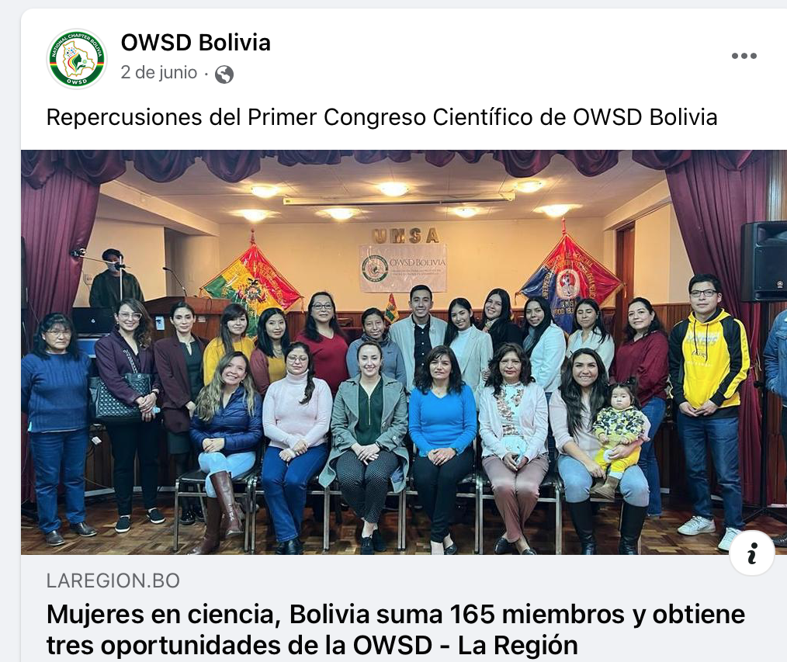
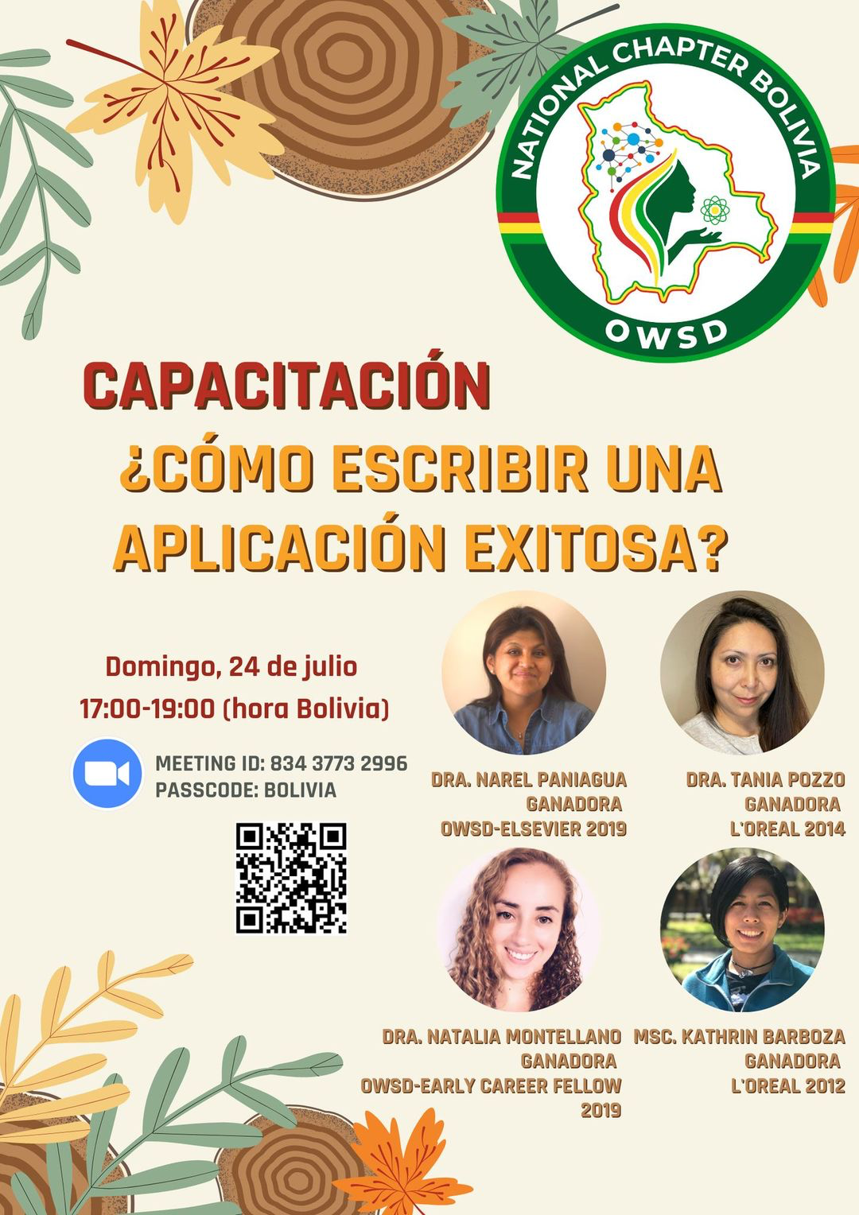
OWSD Bolivia 2022
Exclusive and interactive training to Apply for financing offered by OWSD
The first "National Scientific Congress of the organization for women in science in developing countries, Bolivia chapter" brought together 47 papers on different topics. In addition, it allowed to know the reality and the profile of the researchers.

Slide 5
OWSD BOLIVIA
OWSD Bolivia has 165 members (the second largest after Guatemala) and is the only country in Latin America to have won all three of the organization's top opportunities: an Elsevier Award for Young Scientists won by Narel Paniagua; a PhD Fellowship, which was achieved by Paola Rocabado , and an Early Career Fellowship award, for Natalia Montellano .
https://www.laregion.bo/mujeres-en-ciencia-bolivia-suma-165-miembros-y-obtiene-tres-oportunidades-de-la-owsd/?fbclid=IwAR0g25KQPYnsHbDTng5L5uOTZ6E9B4MVSJl7601v4pKnyzs6Kjg9hNMYFbc

Slide 6
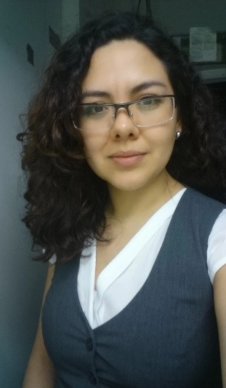
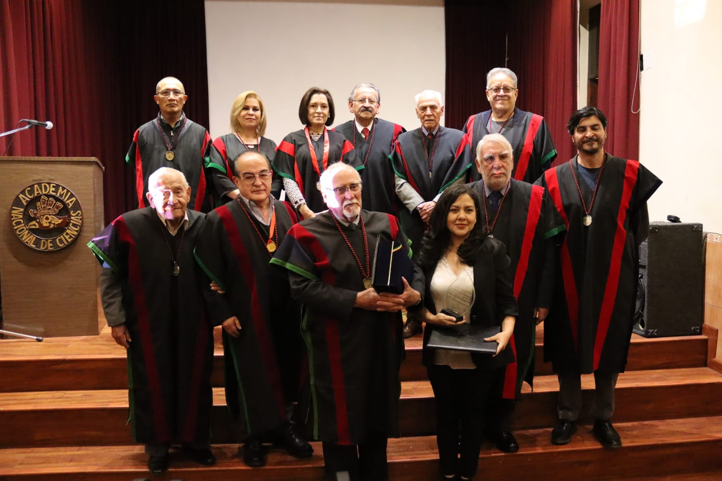
Marie Curie Prize 2022 (ANC)
Carla Fernández Espinoza, PhD
Biologist, Master's degree in Environmental Sciences and a PhD. in Aquatic Resources Engineering.
Universidad Mayor de San Simón, Cochabamba
She has collaborated in studies of limiting factors of abundance and distribution of plankton and she has contributed to several national and international publications on freshwater plankton.

Slide 7
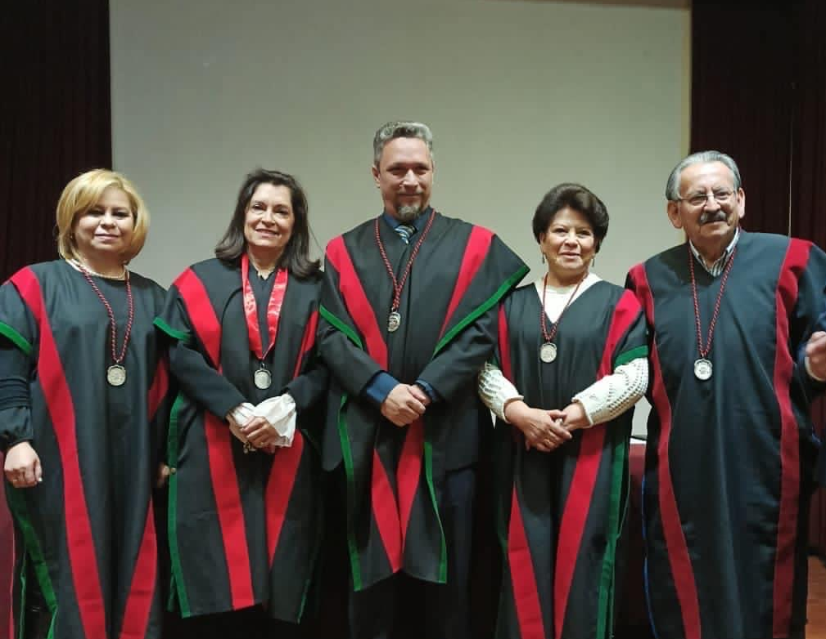
National Academy of Sciences
Scientific activity this year has been almost normal, after certain restrictions last year.
The meetings at the National Academy of Sciences were virtual in a first stage, currently these meetings are in mixed mode (face-to-face and virtual)
This year, for the first time, three scientific women are present on the Directory of the National Academy of Science: The President, the General Secretary and the Treasurer

Slide 8
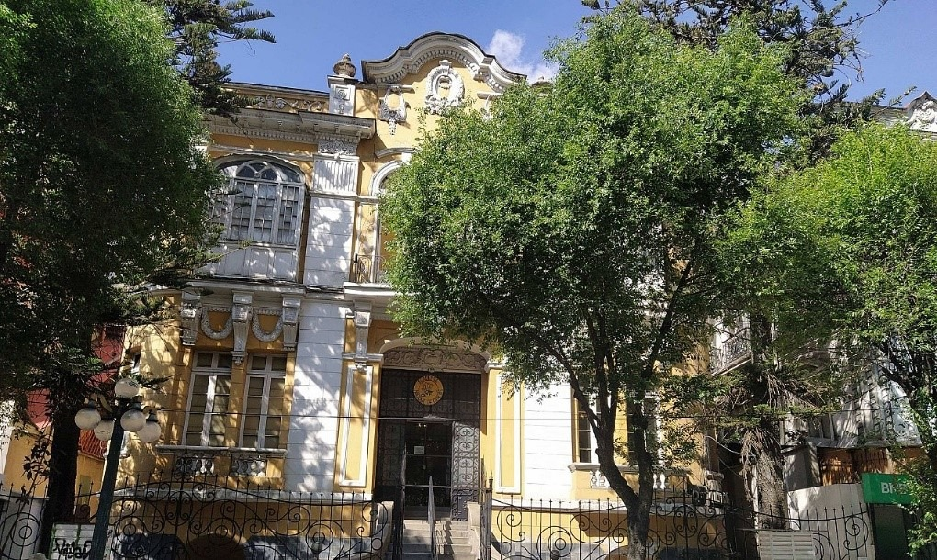
Planned actions for 2023
Marie Curie prize 2023
Meeting of scientific women at the national level
Ongoing gender committee
Entry of three female scientists as number academicians for 2023

