Slide 1

Caribbean Academy of Sciences (CAS) Activities
Professor Neela Badrie
Virtual IANAS Meeting – Women for Science (WfS)
15th December, 2020

Slide 2
CAS Executive-Women on Executive
CAS Position | CAS Regional | CAS Trinidad and Tobago
President | Prof. Emeritus Winston Mellowes | Prof. Kit Fai Pun
Foreign Secretary | Prof. Robert Lancashire
Secretary | Mrs Petal Punalall-Jetoo | Dr. Diane Ignacio
Treasurer | Professor Neela Badrie | Dr. Jeffery Smith
Public Relation Officer | Dr. Mark Wuddivira | Dr. Patrica Sealey
Floor Member |  | Dr. Arlene Williams

Slide 3
CAS Guyana elects New Chapter Executive on February 22, 2020
Dr. Dawn Iona Fox, Lecturer at the University of Guyana, Turkeyen
OWSD-Elsevier Foundation Award for Women Scientists in the Developing World for her work on environmental science
CAS Position | CAS Guyana
President | Ms. Elena Trim
Vice President | Dr. Anna Perreira
Programme Officer | Dr. Jacqueline Murray
Secretary | Mr. Gavin Ramnarajn
Treasurer | Ms. Heetasmin Singh
Assistant Secretary/ Treasurer | Dr. Dawn Fox
Red highlights indicate women on the executive

Slide 4
CAS Activities
Virtual CAS 22nd Conference 9th-14th August, 2021- “Science, Technology and Innovation for Sustainable Development in a Greener Caribbean”,Guyana
Prof Mellowes, CAS President and Dr. Jeffery Smith represented CAS at the Caribbean Innovation Meeting, Le Gosier Guadeloupe in Oct 2019;
Professor Neela Badrie is serving on the InterAcademy Partnership (IAP) on Biosecurity and Statements Committee (Marcos nomination):
Professor Judith Gobin on IAP panel to develop statement for the Protection of the Marine Environment;
Biography of Ms. Nolana Lynch-CEO of Eco-Truffles, Trinidad and Tobago, West Indies

Slide 5
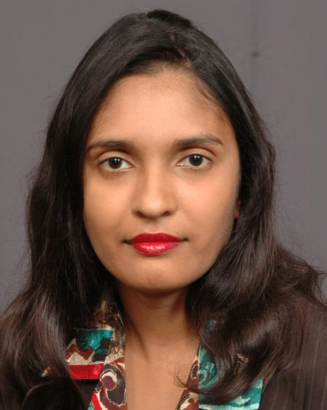
Passing of TWO CAS Executives
Professor Emeritus Tara Dasgupta, Professor of Inorganic
Chemistry, The University of the West Indies, Mona, Jamaica
from COVID-19. He served as CAS President Regionally and
CAS Jamaica;
Dr. Jo-Anne Nina Sewlal, the Secretary of CAS, who passed
away suddenly on 20 January 2020 at the age of 40 years.
At the time of her death, 2020, she was serving as CAS secretary
for the Caribbean region

