Slide 1

IANAS WOMEN FOR SCIENCE FOCAL POINTS MEETING
December 15, 2020
Dr. Liliana López
Venezuela
activities summary

Slide 2
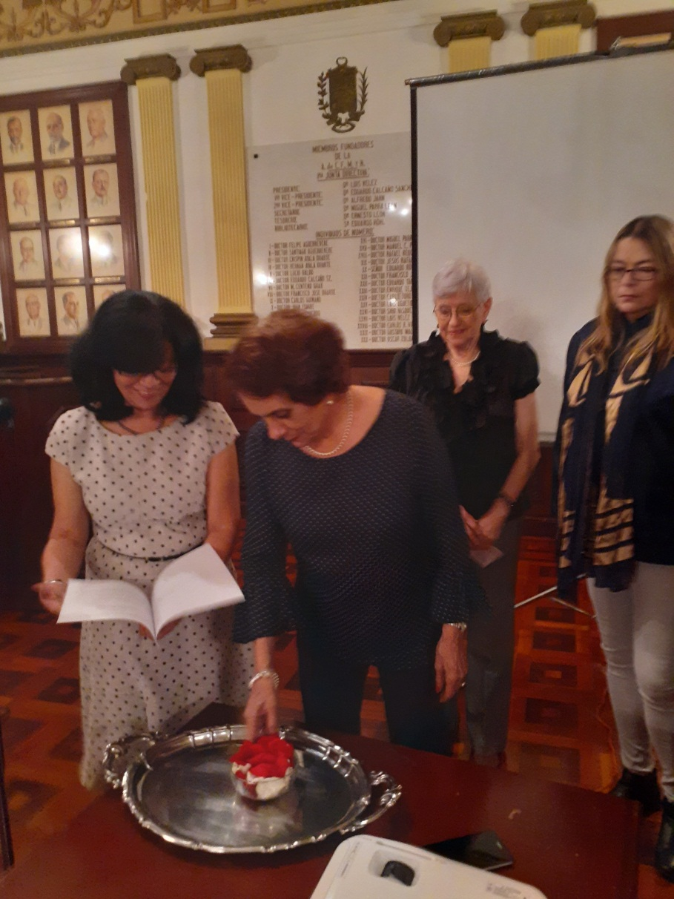
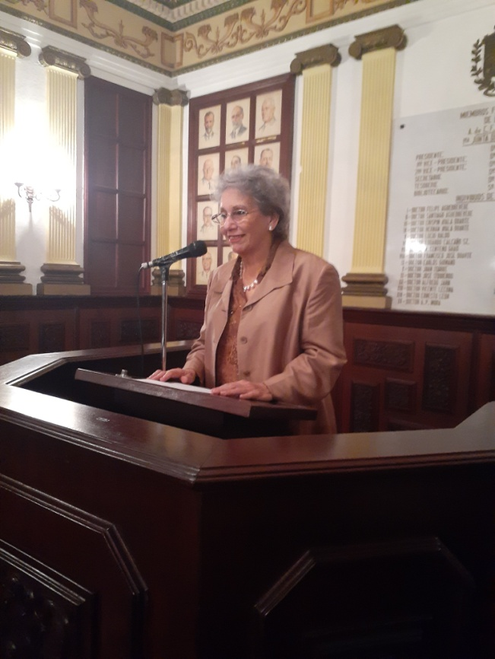

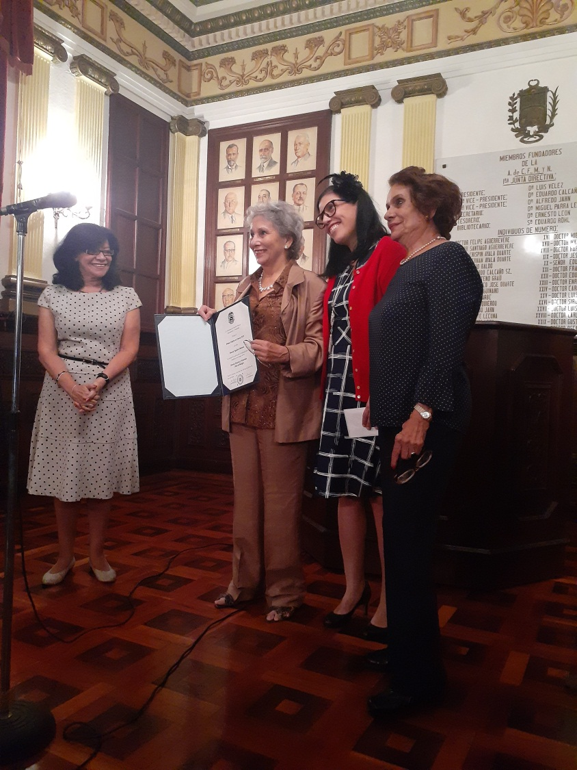
February, 2020
Activities
Women in Science
Prize - 2019
Dr. Marisol Aguilera.
Simon Bolivar University.
Presentation of book "8 questions to Venezuelan women of science”

Slide 3
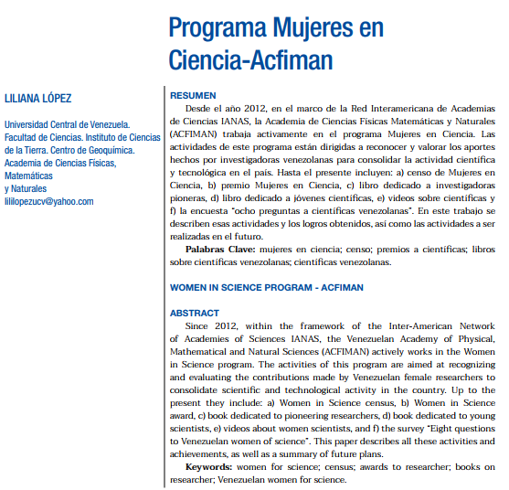
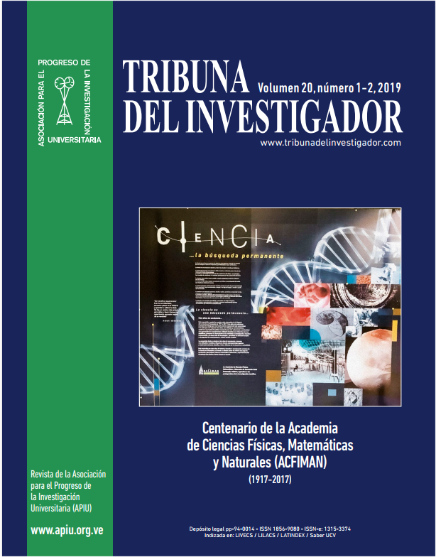
March, 2020
Activities
Article:
WOMEN IN SCIENCE PROGRAM- ACFIMAN
Special issue:
Centenary of ACFIMAN
https://www.tribunadelinvestigador.com/ediciones/2019/1-2/

Slide 4
future plans
1. Meeting Women for Science Venezuela
The objective of this meeting is to inform about how in the past and currently Venezuelan scientists have played important roles in the development of science in our country. This would include historical and current aspects on the role of Venezuelan scientists in the development of science in and outside of Venezuela.
2. Women for Science Network Venezuela
Our Academy has worked through the "Women in Science Program", but we plan to form a "Women in Science Network".

Slide 5


Thanks for you attention

