Slide 1

U.S. National Academies of Sciences, Engineering, and Medicine Response to COVID-19
Marcia McNutt, President

Slide 2
Our Strategy for Responding to COVID-19
  Actionable science, engineering, and medicine to inform immediate decisions related to the crisis
  “Irreplaceable” science, engineering, and medicine to enable learning from unique/ephemeral circumstances of the crisis
  Strategic science, engineering, and medicine to understand the range of possible consequences and identify interventions that could lead to a robust recovery and a more resilient society

Slide 3
Standing Committee on Emerging Infectious Diseases and 21st Century Health Threats
Requested by US Office of Science and Technology Policy (OSTP) & US Department of Health and Human Services Assistant Secretary for Preparedness and Response (ASPR)
Chaired by Harvey Fineberg (NAM), 26 members
Rapid expert consultations on critical questions; 11 completed to date
    Effectiveness of homemade face coverings
    Effectiveness/costs of social distancing
    Possibility of bioaerosol spread
    Crisis standards of care, etc.
Notes:
Example of actionable science. Turnaround times of days/hours. Extremely nimble, responsive approach to the pandemic. Illustrates innovative approaches that are emerging from the Academies Transformation effort.

Slide 4
Societal Experts Action Network (SEAN)
Requested by US National Science Foundation
Executive Committee Co-Chaired by Bob Groves (NAS/NAM) and Mary Bassett (NAM)
Rapid responses to actionable questions with strong social, behavioral, and economic sciences dimensions
To inform decisions by state, local, and federal decision makers
First brief product will identify a set of questions state and local decision-makers can use to understand and evaluate data sources as they make decisions related to COVID-19
Notes:
A second example of actionable science that we recently launched. Will extend/build on the work of the Standing Committee in several important ways: (1) focusing on social, behavioral, and economic science issues; (2) primary audience is state/local decisionmakers (governors, mayors); and (3) leveraging partnerships with other organizations, such as the National Bureau of Economic Research, Social Science Education Consortium, National Governor’s Association (to name a few)

Slide 5
Irreplaceable Science, Engineering, and Medicine
Urgent need to collect data from unintended experiments to help prepare for a possible second wave and future extreme events
Examples:
What can be learned about the effectiveness of different approaches to re-opening research laboratories?
What can be learned about the effectiveness of mitigating the impact of COVID from the various early actions taken across the U.S. and in other countries?
How do wildlife respond when everyone is indoors?
Notes:
Have not begun this work at this point. In discussions with OSTP and coalitions of research universities.

Slide 6
Response and Recovery Strategy Group
Rapid, scenario-based analyses of possible and probable futures
Inform response and recovery decisions (governments, universities, businesses)
Example Scenarios
cascading impacts of a second wave on immigrant farm laborers (worker health, food supplies, regional/national economy)
impacts of various COVID trajectories on the fiscal sustainability and research capacity of the nation’s research universities
Notes:
Example of strategic science. In discussions with federal agencies, foundations, philanthropists to fund. Schmidt Futures has committed $200K. I am using NAS reserve funds to get strategy group started.

Slide 7
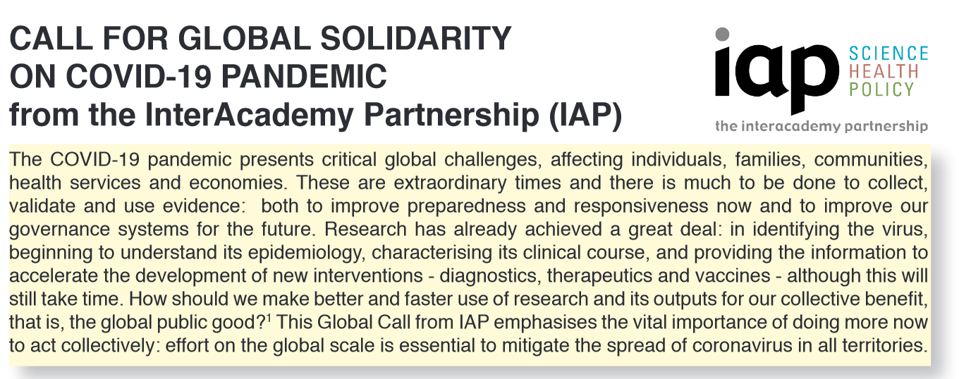
The U.S. National Academies of Sciences, Engineering, and Medicine hosts the IAP Policy Secretariat
IAP call for global solidarity
  Distributed in English, Spanish, Portuguese
IAP collation of how national academies are responding – sharing good practice
  Issuing statements
  Highlighting response of science community
  Devising medical ethics guidelines
  Sourcing reliable data and guidance
  Making journals relevant to COVID-19 open access
Joint statement of 16 academies of Science and of Medicine recommending key areas of international research cooperation
  Includes Brazilian Academy of Sciences and US National Academy of Medicine
See more at:
www.interacademies.org
Notes:
IAP – the global network of over 140 science, engineering and medical academies – responded quickly to the growing pandemic crisis, producing a communique signed by its leadership, a short video, and an ongoing collation of how academies are responding in their own countries to share good practice and inspire other academies to be proactive. Examples of actions taken by some academies listed above.
The emphasis has been on ACTION – the need to do more now to act collectively (internationally, not entrenched nationally):
(1) To collect, validate, share and use evidence to improve preparedness and responsiveness now and governance systems for the future; and
(2) To help less developed countries, with weaker public health systems and science advisory mechanisms, to cope.

