Slide 1
Without a mitigation strategy and without science, Nicaragua won’t be able to overcome the threats of the coronavirus pandemic. Role of the Academy of Sciences of Nicaragua
Jorge A. Huete-Pérez, PhD
Academy of Sciences of Nicaragua
IANAS. June 1, 2020

Slide 2
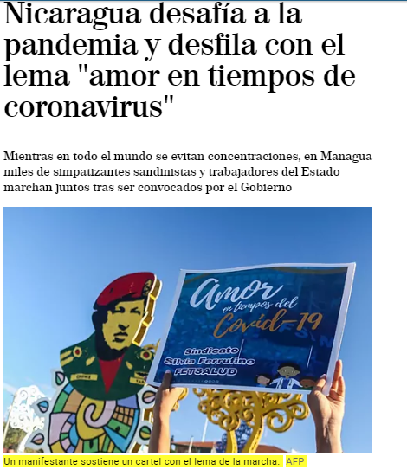
The government has adopted no health measures to address the pandemic.
The government ignored WHO recommendations for massive testing, quarantine and social distancing.
While the pandemic rages around the world, forcing nations to address the crisis pro-actively, in Nicaragua all throughout the pandemic the government has been sponsoring rallies, fairs and sporting venues.

Slide 3
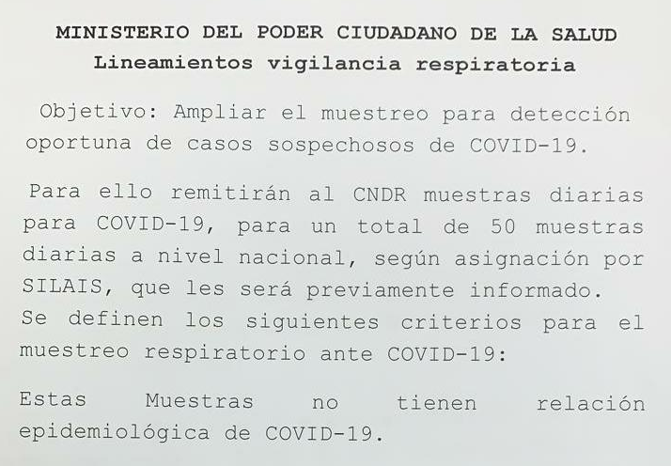
Lack of diagnostic tests, a primary bottleneck
The alteration of the testing results led to a complete disconnect in the government statistics.
In the first days of May, they introduced an unbelievable mortality rate of 27%, among the highest in the world.
Until mid-May data from the central lab showed a contagion rate of 27%.
On May 19, in just one week, Nicaragua officially went from 25 cases of COVID-19 to 279, an increase of 1000%, a world record.
Notes:
On May 19, in just one week, Nicaragua officially went from 25 cases of COVID-19 to 279, an increase of 1000%, a world record.

Slide 4
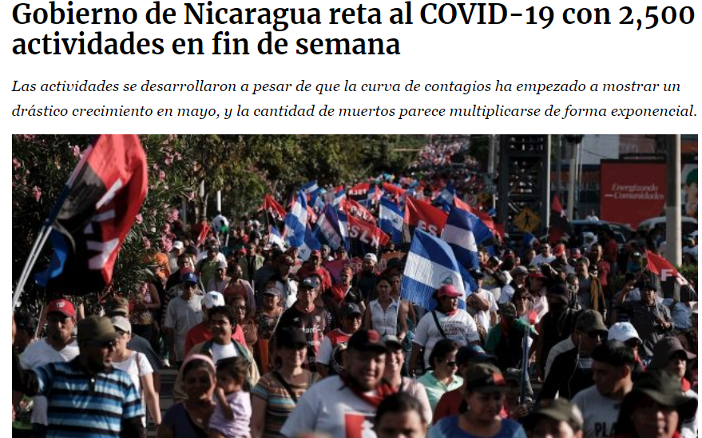
As the government refuses to mitigate the spread of the virus, the Academy of Sciences have been questioning the government lack of actions.
By not promoting social distancing and encouraging touristic and business activities, acted contrary of what a system focused primarily on prevention and community health would recommend: Prevention
The government defends its actions relying on the absurd argument that Nicaragua has “the best health system in the Americas”.
Notes:
On May 19, in just one week, Nicaragua officially went from 25 cases of COVID-19 to 279, an increase of 1000%, a world record.

Slide 5
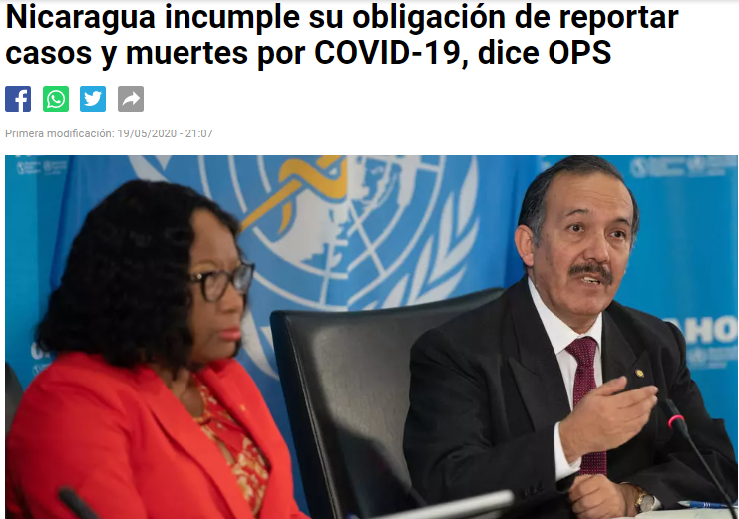
Measures to Fight Coronavirus are Inadequate
In the absence of effective containment, it is overwhelming the precarious health system
Many doctors and nurses are getting sick without the appropriate safety equipment, weakening the health response.
About half a million Nicaraguans suffered from chronic diseases in 2019
PAHO: Nicaragua breaches its obligation to report cases and deaths from COVID-19
Doing nothing, is always worse than overreacting.
Notes:
On May 19, in just one week, Nicaragua officially went from 25 cases of COVID-19 to 279, an increase of 1000%, a world record.

Slide 6
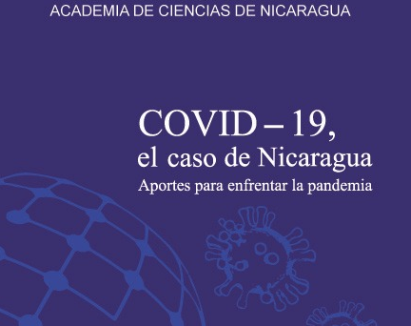
The Academy of Sciences urged the government to implement mitigation
The Academy has urged the government to scale up testing, isolation and contact tracing of COVID-19 patients.
ACN has published 4 statements and a book on coronavirus, addressing the COVID-19 threats (free on line).
It also urged the government to consult with scientists and experts so that decisions are made based on scientific knowledge
Government actions are undermining the credibility of research institutions such as the National Center for Diagnosis and Reference which performs Covid-19 testing.
They also impact universities’ scientific research, already severely limited due to 2018 sociopolitical rebellion (brutal repression), bringing education and research to a virtual standstill
Notes:
On May 19, in just one week, Nicaragua officially went from 25 cases of COVID-19 to 279, an increase of 1000%, a world record.

Slide 7
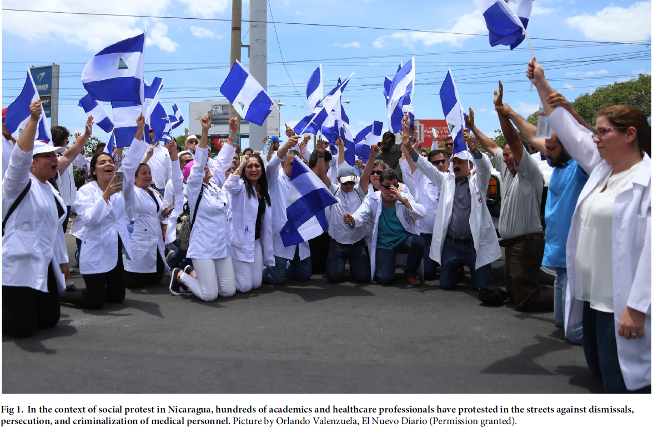
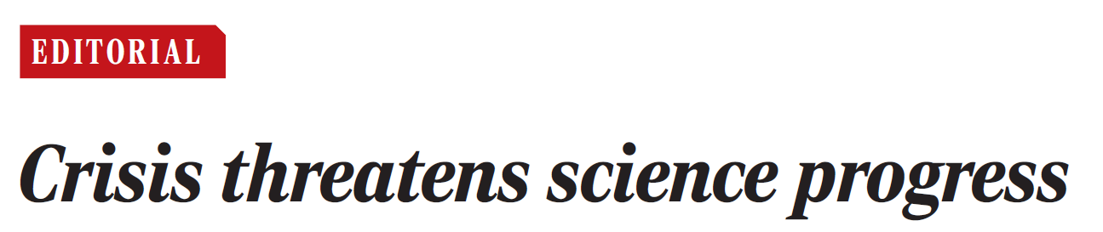
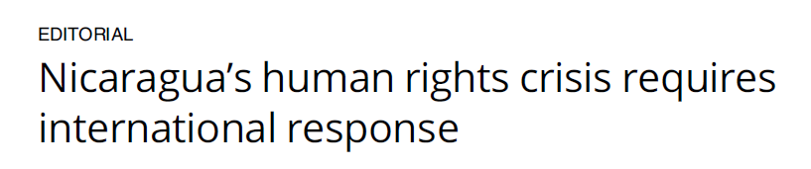
Academy´s role in contributing to solving the current sociopolitical crisis
Academy´s role in demanding transparency on COVID 19 crisis

Slide 8
The Nicaraguan case as example for other countries and the need of international support
This experience could be relevant for scientists working under precarious political conditions and where political environments are hostile to scientists and scientific unions, making science advising extremely complicated.
There is an urgent need for the international community to lend their support to finding a solution to this desperate situation in Nicaragua.
Moreover, the support of global scientific societies could be decisive to help in rebuilding institutions and infrastructure for education and science.

Slide 9
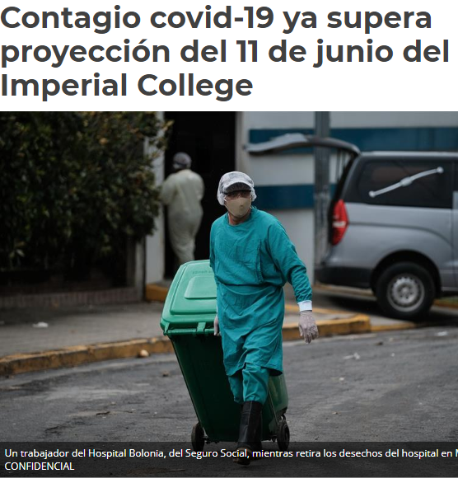
There was no suppression nor mitigation strategy to prevent the virus´s spread in Nicaragua
Lack of actions had horrific impact on healthcare of citizens
A country without policy and rigorous actions for limiting the spread of a disease poses a regional threat. Government´s lack of transparency & playing down the COVID-19threats had terrible consequences on health of Nicaraguan citizens and undermined science and education.

