Slide 1

National Academy of Medicine Brazil
COVID-19 response – actions and practices

Slide 2
Overview
1829.
100 academicians, all physicians: 40 in clinical medicine, 40 in surgery and 20 in applied sciences.
Traditional role on education, lobbying and advising the federal government as well as the states government officers.

Slide 3
Understanding the role of merit-based Academies the ANM chose to maintain its activities - with home-office staff and the traditional Thursday afternoon evening sessions held though zoom with a weekly audience of 150 to 250 building the NAM’s Web Hall.
- science based medicine available to society and the different aspects of the COVID-19 pandemic such as: basic and clinical aspects, epidemiology, the use of new technologies available to physicians as well as the press and key opinion leaders, also outside Medicine.
Recently has also started to discuss the post peak COVID practice of Medicine and interactions with other diseases (such as cancer).

Slide 4
Scientific “lobby”
Given the complex political scenario in Brazil, the National Academy of Medicine is strongly supporting and practicing scientific lobby, including articulation with key opinion leaders and the issuing of statements and letters to the society and authorities of Federal and State levels.
On this matter, NAM has been permanently interacting with other scientific institutions such as the Brazilian Academy of Sciences, Brazilian Medical Association and Brazilian Academy of Pharmaceutical Sciences. Common Documents, Statements etc
Journalists also part of ANM programs.
Academicians have published more than 50 articles in the most importante Brazilian newspapers

Slide 5
Efforts to cope with COVID-19 – Joint Meetings
Starting last April
joint meetings with experts with different Academies of Medicine:
Portugal;
United Kingdom; (other beung developed in June)
France;
China;
Latin American Association of National Academies of Medicine, Spain and Portugal

Slide 6
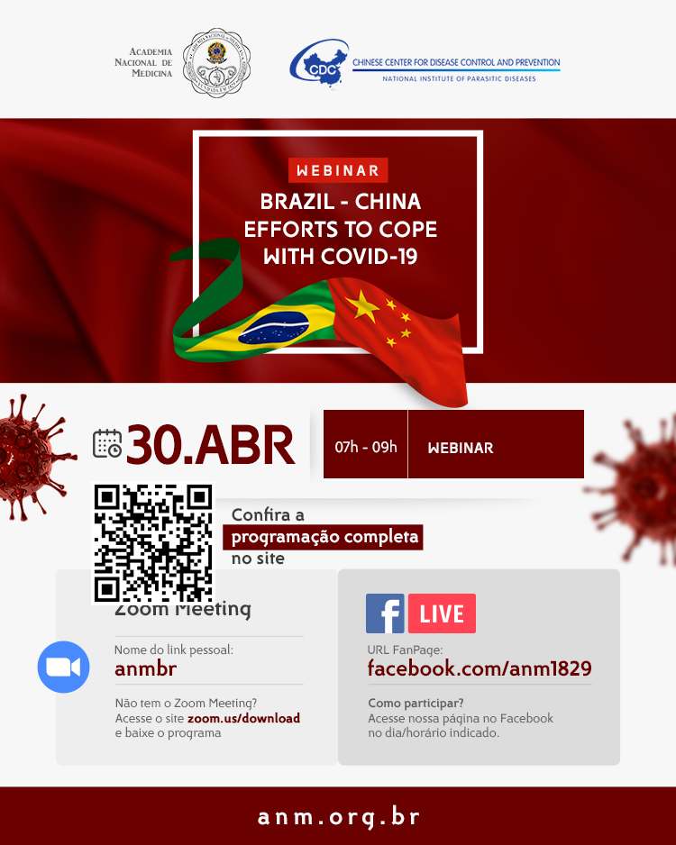
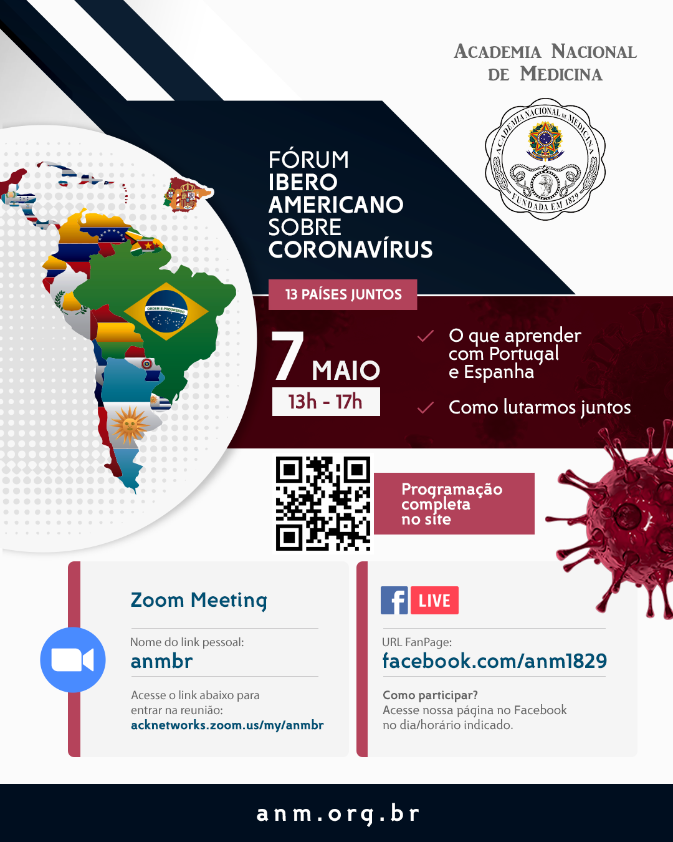

Slide 7



Slide 8
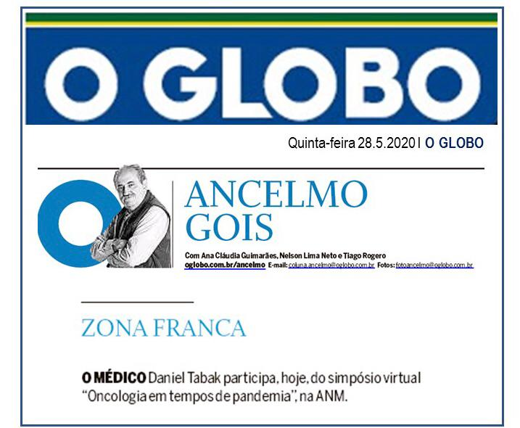
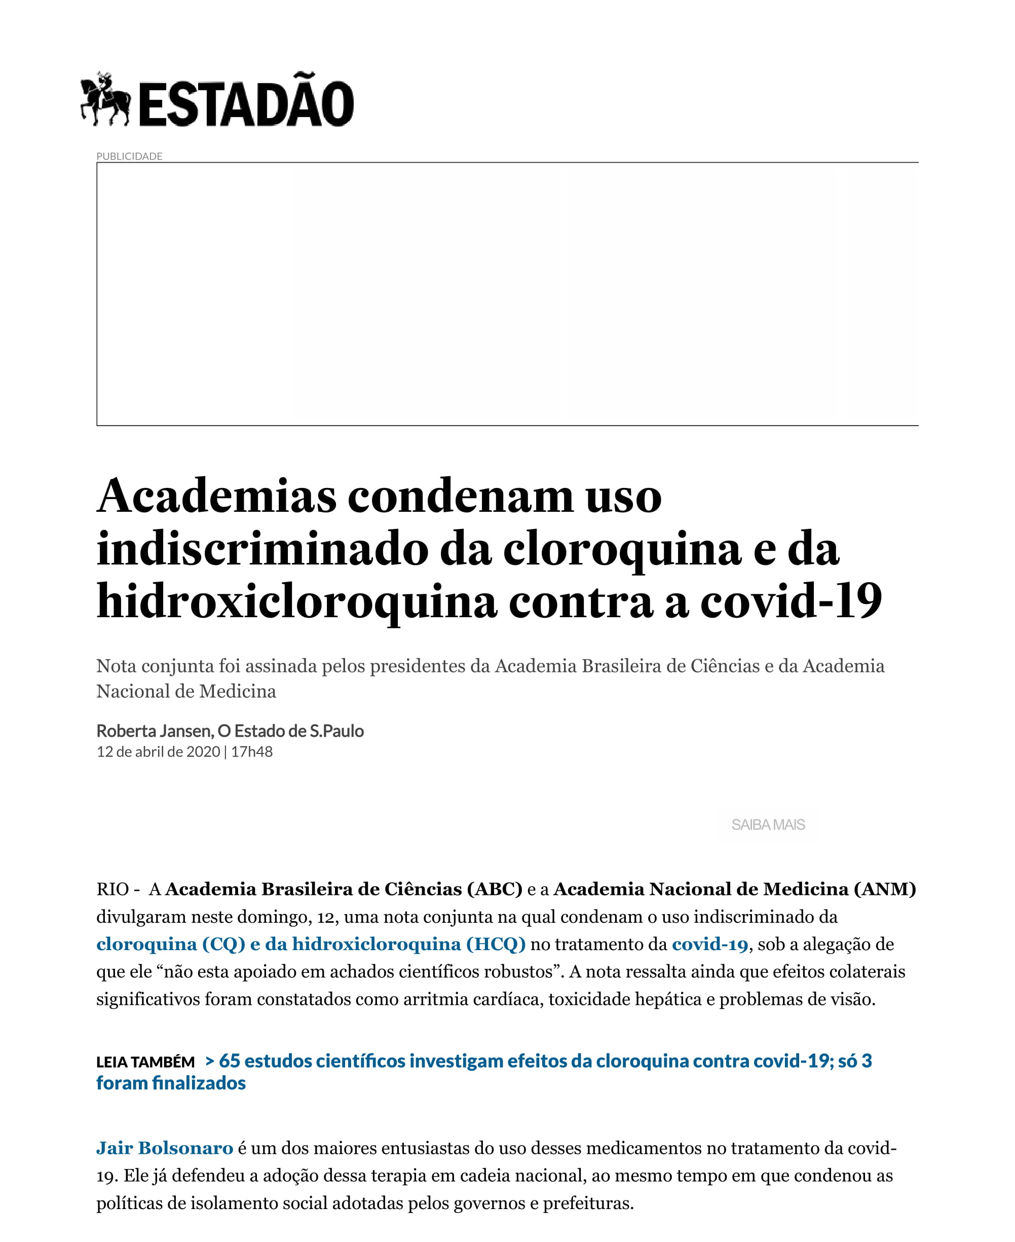
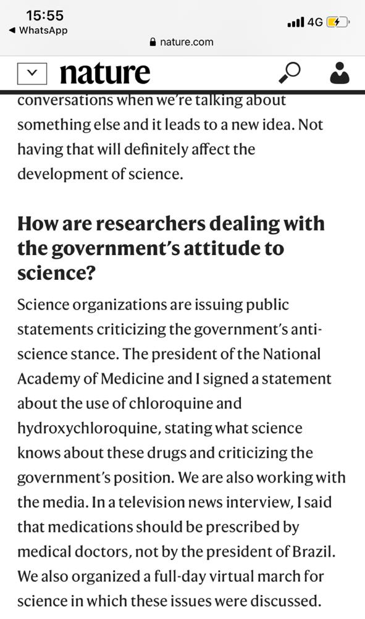

Slide 9
Social Media – over 1 million views
Importance of communications, Face Book, Instagram.
Number of initiatives aiming to improve kowledge of the pandemic understanding of the disease by the Brazilian Society ( Information and Education).
Eg “One minute on COVID-19” YouTube, that releases weekly a short video on different approaches on COVID-19.
Over 20 Podcasts have been launched covering aspects of the disease in the different medical specialties

Slide 10
“Talking on Mental Health”
The National Academy of Medicine is also conducting programs aimed at providing support (especially on mental health) to Brazilian fellows based abroad during the pandemic.
The “Conversando sobre Saúde Mental” (“talking on mental health”) initiative is conducted with the Lemann Foundation and is currently providing support to over 40 fellows mpstly in Brazil, US and Europe.

Slide 11
National Academy of Medicine Brazil
COVID-19 response – actions and practices
Prepare for the worse
Aiming for the better
Together with Solidarity and looking for Equality

Slide 12


